Slide 1
Introduction to JavaScript API
JavaScript API (Application Programming Interface) is a set of pre-defined functions and objects that allow interaction with web pages dynamically.

Slide 2

What is JavaScript API?
JavaScript API enables developers to access and manipulate web page elements dynamically. It provides a set of functions and objects for this purpose.

Slide 3
Benefits of Using JavaScript API
1. Enhanced Interactivity: JavaScript API allows for the creation of highly interactive and dynamic web applications.
2. Simplified Development: Developers can access ready-made functions and objects, reducing development time and effort.
3. Seamless Integration: JavaScript API can be easily integrated with existing web technologies like HTML and CSS.

Slide 4
Using Browser APIs
DOM (Document Object Model) API: Allows manipulation of HTML and XML documents. Developers can dynamically access and modify the structure, style, and content of web pages using methods and properties provided by the DOM API.
Fetch API: A modern replacement for XHR, Fetch API provides a more flexible and powerful interface for fetching resources asynchronously across the network. It supports promises, making it easier to work with than XHR.
Canvas API: Allows dynamic, scriptable rendering of 2D shapes and bitmap images. Developers can use Canvas API to create graphics, animations, games, data visualizations, and other rich multimedia content directly within the browser.
Web Audio API: Enables manipulation and synthesis of audio within the browser. Developers can create and control audio streams, apply effects, analyze audio data, and build interactive audio applications directly in the browser.
。。。 。。。

Slide 5
DOM API
<script>
document.getElementById('add').addEventListener('click', addItem);
function addItem() {
let itemInput = document.getElementById('itemToAdd');
let toDoList = document.getElementById('toDoList');
let newItem = document.createElement('li');
newItem.innerHTML = itemInput.value;
toDoList.append(newItem);
itemInput.value = '';
}
</script>

Slide 6
Web Storage API
The Web Storage API provides a mechanism for preserving non-essential state across requests and even across sessions. It comes in two varieties:
localStorage is a dictionary of strings that lasts until removed from the browser.
sessionStorage is also a dictionary of strings but only lasts as long as the browsing session.
To add a string to either involves calling the setItem() method of the localStorage or sessionStorage objects.
To retrieve a value from either simply requires using the getItem() method.
https://www.w3schools.com/js/js_api_web_storage.asp

Slide 7
GeoLocation
The Geolocation API provides a way for JavaScript to obtain the user’s location (accuracy/availability dependent on permission and device)
if (navigator.geolocation) {
navigator.geolocation.getCurrentPosition(hav eLocation,geoError);
} else {
// geolocation not supported or accepted
...
}
function haveLocation(position) {
const latitude = position.coords.latitude;
const longitude = position.coords.longitude;
const altitude = position.coords.altitude;
const accuracy = position.coords.accuracy;
// now do something with this information
...
}
function geoError(error) { ... }
https://www.w3schools.com/js/tryit.asp?filename=tryjs_api_geolocation

Slide 8
Using External APIs
An external API refers to objects with events and properties that perform a specific task that you can use in your pages.
Unlike browser APIs, these external APIs are not built into the browser but are external JavaScript libraries that need to be downloaded or referenced and added to a page via a <script> tag.
In this section, we will look at two of the most popular ones: the Google Maps API

Slide 9
Google Maps API
Notice that this API cost fees
<head>
…
<style>
#map {
height: 500px;
}
</style>
<script>
function initMap() {
const map = new google.maps.Map(document.querySelector('#map'), {
center: {lat: 51.011179,
lng: -114.132866},
zoom: 14
});
}
</script>
<script src="https://maps.googleapis.com/maps/api/js?key=YOUR-API-KEY&callback=initMap" async defer>
</script>
</head>
<body>
Populating a Google Map
<div id="map"></div>
</body>
</html>
LISTING 10.14 Webpage to output map centered on a location

Slide 10
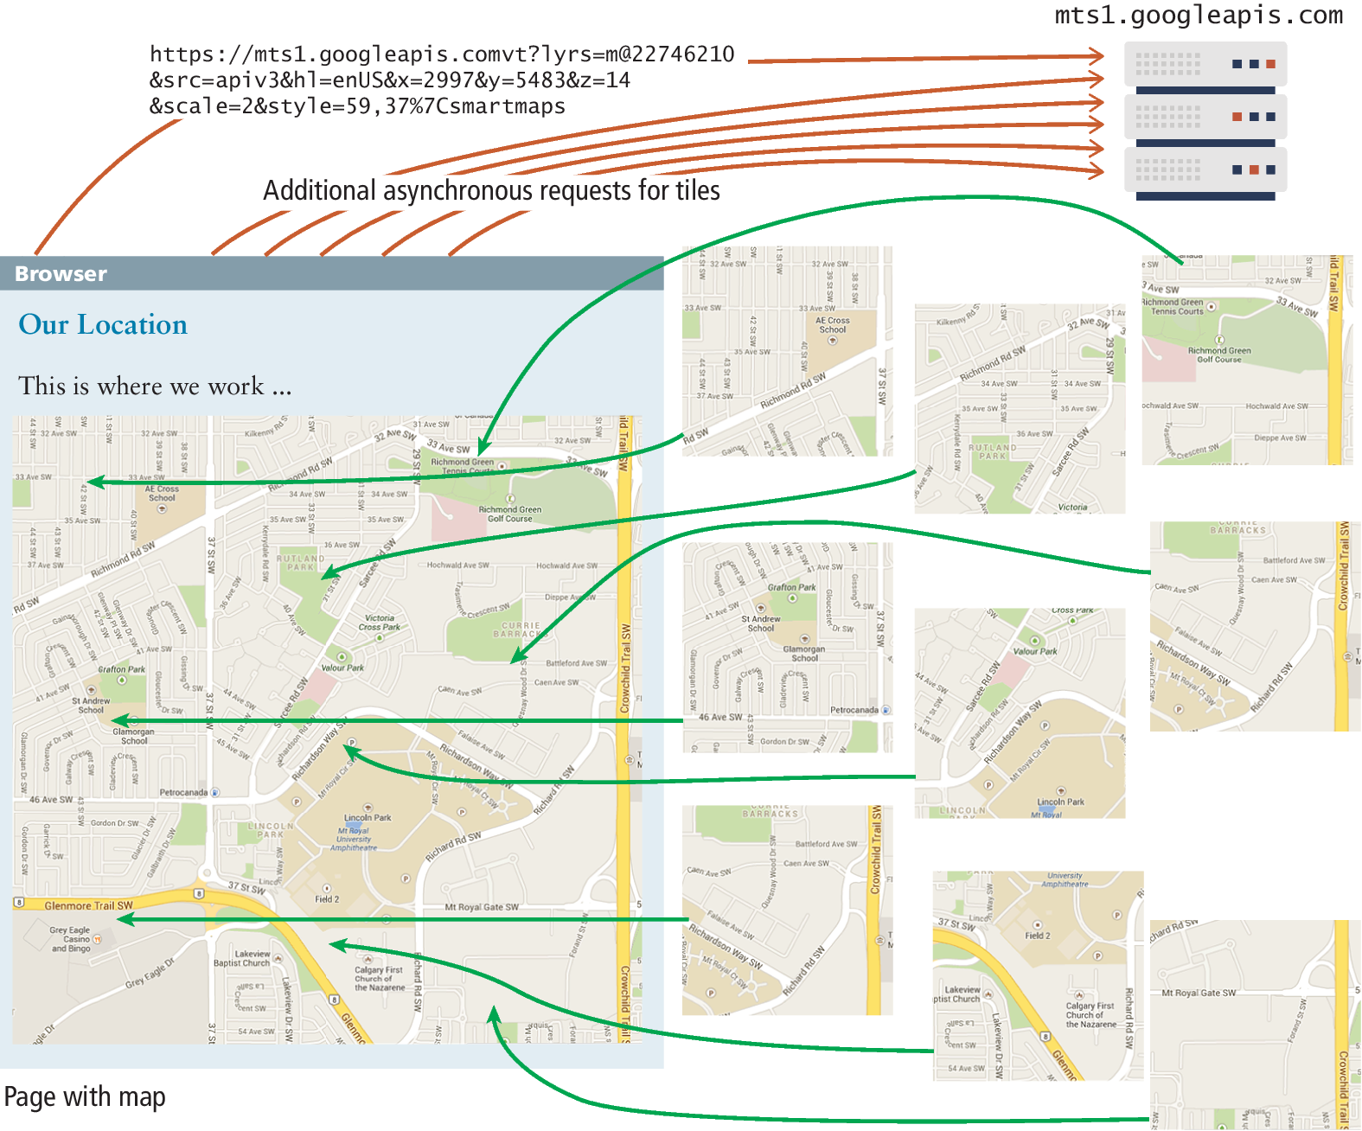
Google Maps at work

Slide 11
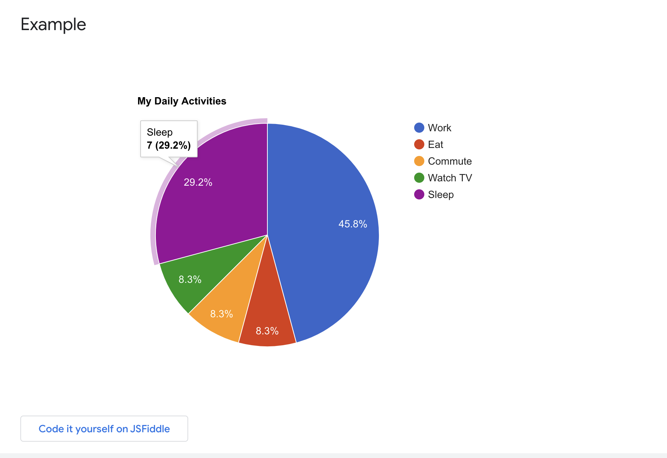
Google Chart
/* generate the chart */
<script type="text/javascript" src="https://www.gstatic.com/charts/loader.js"></script>
<script type="text/javascript"> google.charts.load('current', {'packages':['corechart']}); google.charts.setOnLoadCallback(drawChart); function drawChart() { var data = google.visualization.arrayToDataTable([ ['Task', 'Hours per Day'], ['Work', 11], ['Eat', 2], ['Commute', 2], ['Watch TV', 2], ['Sleep', 7] ]); var options = { title: 'My Daily Activities' }; var chart = new google.visualization.PieChart(document.getElementById('piechart')); chart.draw(data, options); } </script>
LISTING 10.15 Displaying a pie chart

Slide 12
Lightbox 2

Slide 13
Other JS Frameworks

Slide 14
Introduction to jQuery
jQuery is a fast, small, and feature-rich JavaScript library. It makes things like HTML document traversal and manipulation, event handling, and animation much simpler with an easy-to-use API that works across a multitude of browsers.

Slide 15
What is jQuery?
jQuery is a JavaScript library designed to simplify HTML DOM tree traversal and manipulation, as well as event handling, CSS animation, and Ajax interaction.

Slide 16
Features of jQuery
1. DOM Manipulation: Easily manipulate HTML elements and attributes.
2. Event Handling: Simplify handling of user interactions.
3. Animation: Create smooth animations and effects.
4. AJAX: Facilitate asynchronous data loading and interaction with servers.
5. Cross-browser Compatibility: Ensure consistent behavior across different browsers.

Slide 17
How to Use jQuery
1. Include jQuery library in your HTML document using <script> tag.
2. Write jQuery code within <script> tags or in separate JavaScript files.
3. Access HTML elements using jQuery selectors and manipulate them with jQuery methods.

Slide 18
Basic jQuery Syntax
$('selector').action()

Slide 19
jQuery Event Handling
jQuery simplifies event handling with methods like .click(), .hover(), etc.

Slide 20
Example
https://javascriptbook.com/code/c07/form.html

Slide 21
Introduction to Vue.js
Vue.js is a progressive JavaScript framework used for building user interfaces. It is designed from the ground up to be incrementally adoptable, making it easy to integrate into existing projects.

Slide 22
What is Vue.js?
Vue.js is a JavaScript framework for building interactive web interfaces. It focuses on the view layer of an application, providing tools for data binding, component-based architecture, and declarative rendering.

Slide 23
Features of Vue.js
1. Reactive Data Binding: Automatically update the view when data changes.
2. Component-Based Architecture: Encapsulate UI functionality into reusable components.
3. Directives: Provide additional functionality to HTML elements.
4. Virtual DOM: Improve rendering performance by minimizing DOM manipulations.

Slide 24
Getting Started with Vue.js
1. Include Vue.js library in your HTML document.
2. Create a Vue instance to bind data and methods to the view.
3. Use Vue directives to add dynamic behavior to HTML elements.

Slide 25
Key Terms
Geolocation API
localStorage
Jquery
Vue.js
Progressive Web
Applications (PWA)
TypeScript
web API
Web Storage API

Slide 26
Conclusion
JavaScript API is a powerful tool for creating dynamic and interactive web applications. By leveraging its functions and objects, developers can enhance user experience and streamline development processes.

